Slide 1
Module 2
Linear Algebra

Slide 2
Linear Equation
An Equation in which variable’s highest power is 1
X + 4 = 9
Y + 5 = 0
In general form
a1x1+a2x2+a3x3+ +anxn = C

Slide 3
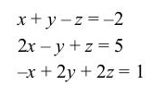
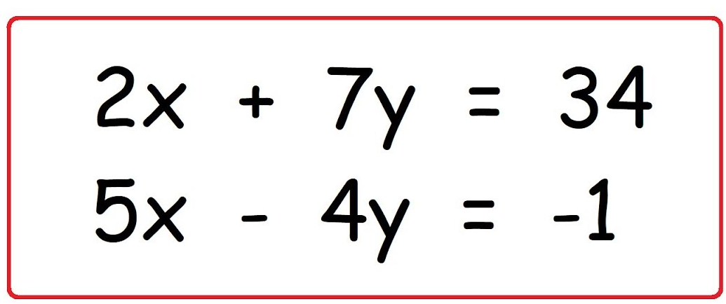
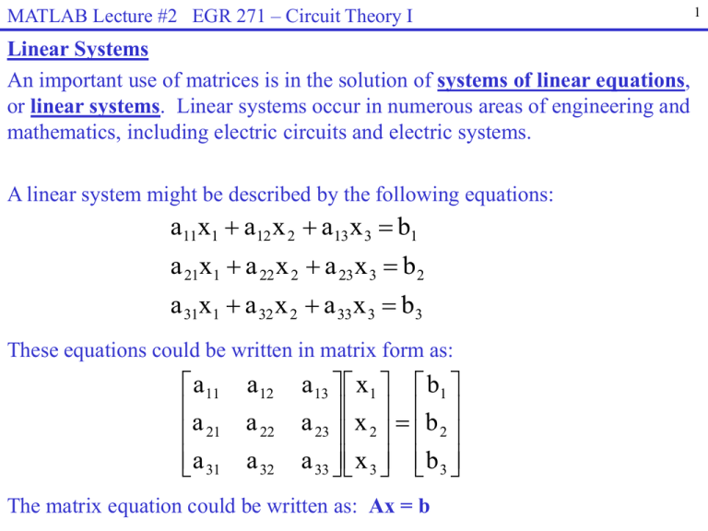
System of Linear Equation
A system(group) of two or more linear equation involving same variables is called system of linear equations

Slide 4
System of Linear Equation

Slide 5
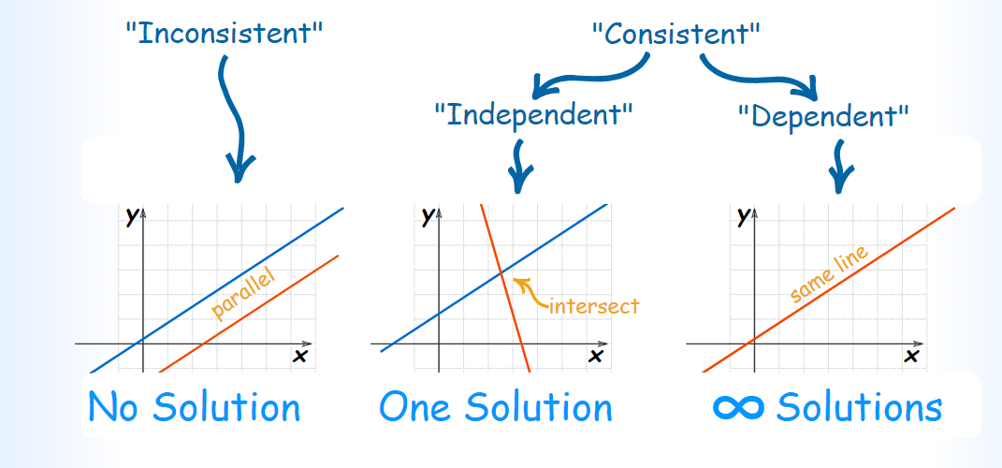
System of Linear Equation

Slide 6
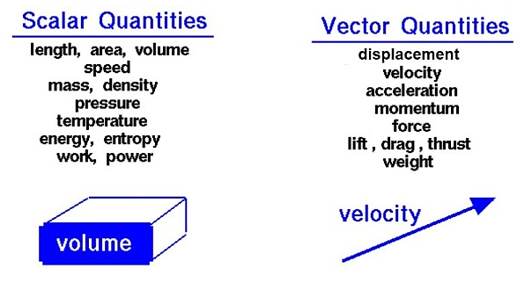
Vectors vs Scaler
A quantity that has magnitude but no particular direction is described as scalar. A quantity that has magnitude and acts in a particular direction is described as vector.
V <2,3>
V <1,2>

Slide 7

Tensors
ML generalization of vectors and matrices to any number of dimensions
Name Dimension Description
Scalar x 0 magnitude only
Vector [ x1,x2,x3] 1 array
Matrix 2 flat tables
3 3D table i.e cube
n-tensor higher dimension
$$\begin{matrix}x11 & x12 & x13 \\ x21 & x22 & x23\end{matrix}$$

Slide 8
Vectors
One dimensional array of number
Denoted in lowercase,italics,bold
Arranged I so not bolsn order,so element can be accessed by its index
Element are scaler
Representing a point in space
Vectors of length two represents location in 2D matrix.
Length of three represents location in 3D cube
Length of n represents location in n-dimensional tensor.

Slide 9
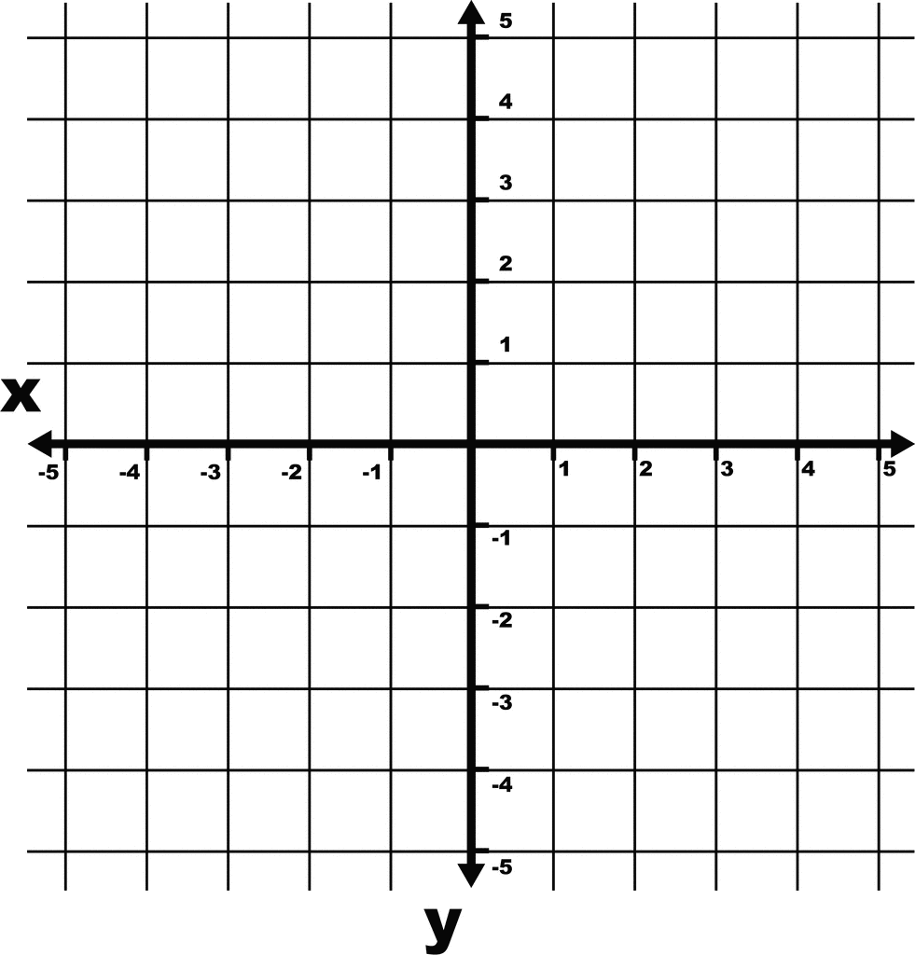
Vector vs Point
P (2,3)
V <1,2>
A Point has position in space. The only characteristic that distinguishes one point from another is its position. A Vector has both magnitude and direction, but no fixed position in space. Geometrically, we draw points as dots and vectors as line segments with arrows.
Vectors represent a magnitude and direction from origin

Slide 10
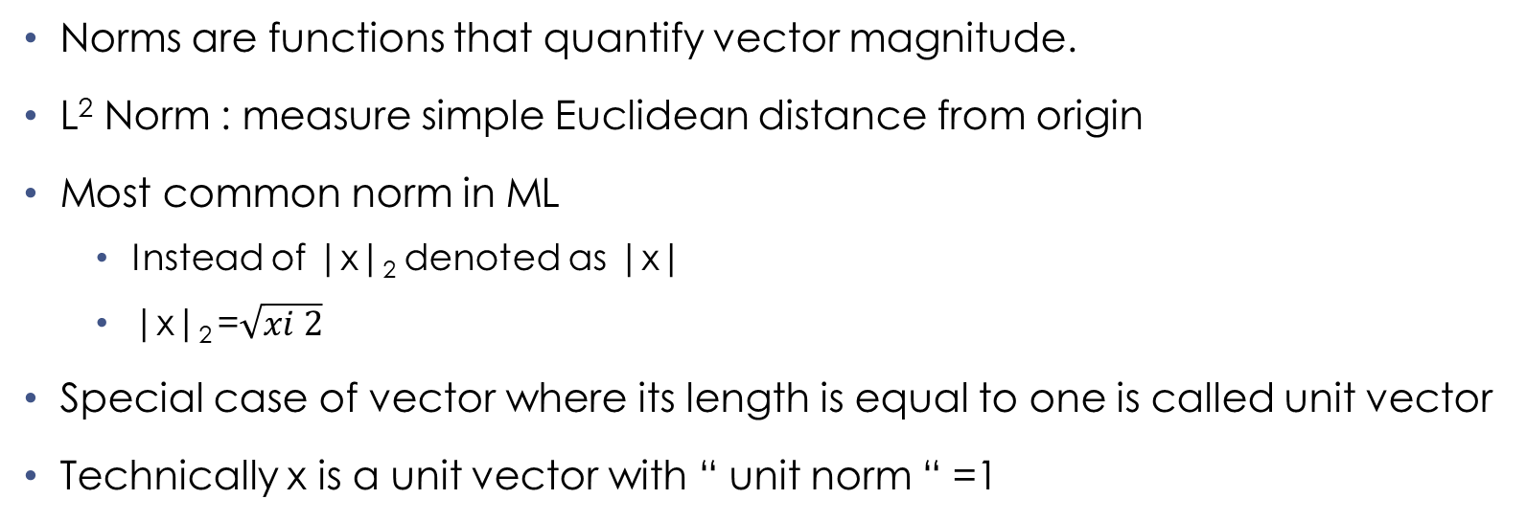
Norms
Norms are functions that quantify vector magnitude.
L² Norm : measure simple Euclidean distance from origin
Most common norm in ML
Instead of |x|₂ denoted as |x|
|x|₂ =$\sqrt{xi 2}$
Special case of vector where its length is equal to one is called unit vector
Technically x is a unit vector with “ unit norm “ =1

Slide 11
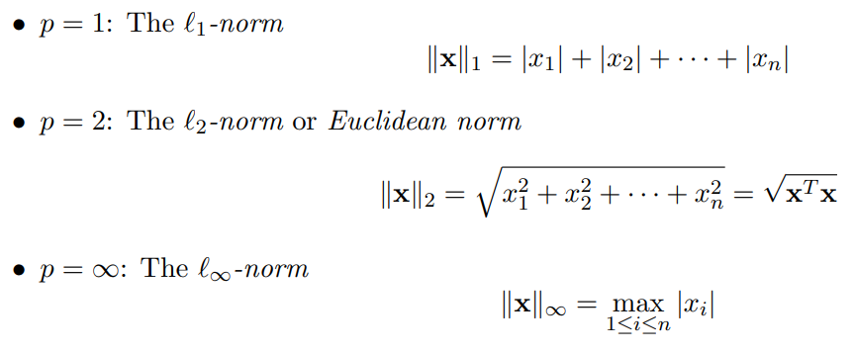
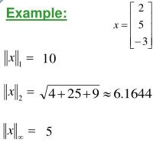
Vector Norms

Slide 12
Basis vectors
Can be scaled to represent any vector in a given vector space
i(1,0)
J(0,1)
Can be scaled to
V = 2.i+ 3.j

Slide 13
Orthogonal vectors
X and y are orthogonal vectors if Xty=0
Are at 90 degree to each other ( non zero norms)
N dimensional space has max n mutually orthogonal vectrors
Orthonormal vectors are orthogonal and all have unit norm
Basis vector are an example

Slide 14
Types of Vector
Parallel vector
Orthogonal Vector
Orthonormal vector
Like vector/ Unlike vector
Equal vector
Collinear vector : sample plane opposite direction
Unit vector
Position vector : pass through origin
Zero vector : magnitude zero

Slide 15
Unit Vector
A unit vector in a given direction is a vector with magnitude one in that direct. Used to represent that direction of a vector
a = [3,4]
|a|=5
Ax = 3/5
Ay = 4/5
||a||=1

Slide 16
Position Vector
A= 2i + 3j + k
||a||= sqrt (14)
Unit vector =1
A vector that start from origin (o) is called position vector.

Slide 17
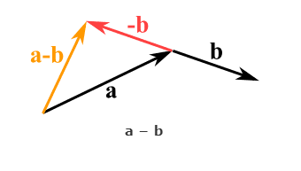
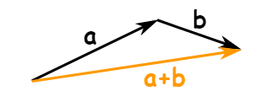
Vector Operation Addition and Subtraction

Slide 18
Vector operation ( Dot Product) Output is scalar
a. b = |a||b| cos (theta)
a.b = a1b1+a2b2+--- +anbn
Example(2,2,-1) (5,-3,2)

Slide 19
Vector Operation (cross product) Output is vector
A * B = |a||b| sin (theto) n
n denote direction (unit vector = magnitude)
A= (3,-3,1) b=(4,9,2)
Example 1 a = <-4,3,0> b=<2,0,0>
i j k |a| = 5 |b|=2
3 -3 1 a*b= -6
4 9 2 sin-1(6/10)= 36.87
-15i-2j+39 k

Slide 20
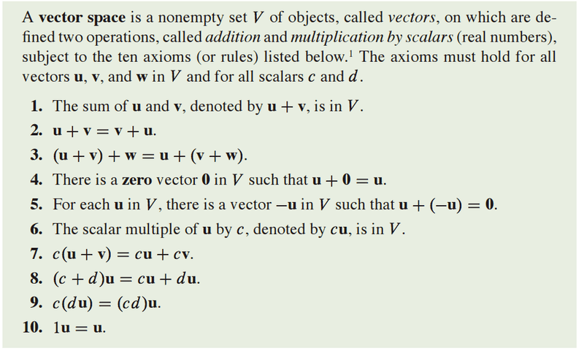
Vector Space

Slide 21
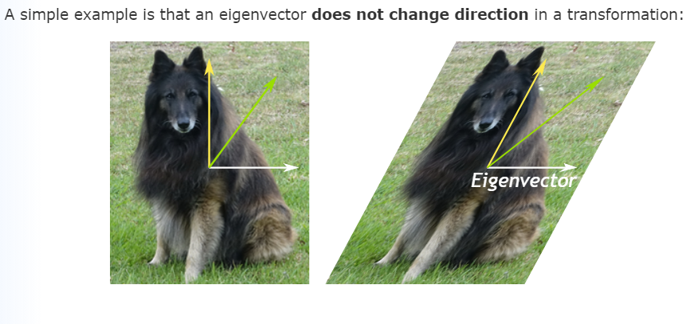
Eigenvector and Eigenvalue

Slide 22
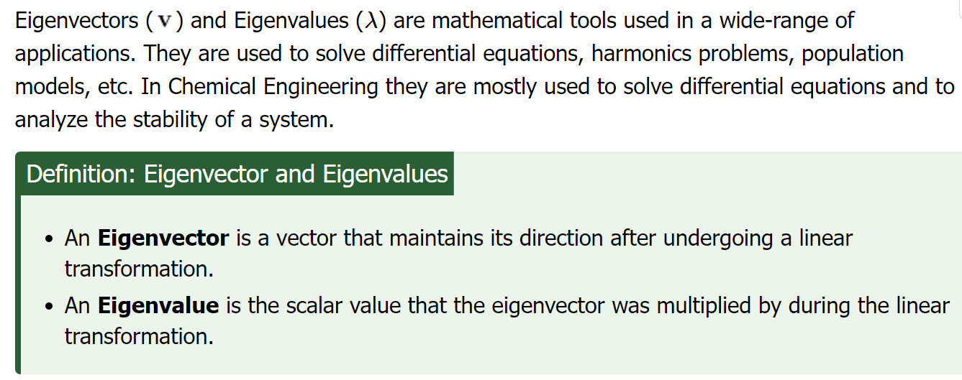
Issues with ML
Inadequate Training Data/ Poor Quality of data : data plays a vital role in the processing of machine learning.
Overfitting : Whenever a machine learning model is trained with a huge amount of data, it starts capturing noise and inaccurate data into the training data set. It negatively affects the performance of the model
Methods to reduce overfitting:
Increase training data in a dataset.
Reduce model complexity by simplifying the model by selecting one with fewer parameters
Ridge Regularization and Lasso Regularization
Early stopping during the training phase
Reduce the noise
Reduce the number of attributes in training data.
Constraining the model.

Slide 23

Matrix
A matrix is a 2 dimensional array of scalars with one or more columns and one or more rows [laymen definition]
$\begin{matrix}2 & 5 & 8 \\ 1 & 2 & 5\end{matrix}$
$\begin{matrix}5 & 8 & 7 \\ 0 & 3 & 8 \\ 0 & 0 & 1\end{matrix}$

Slide 24
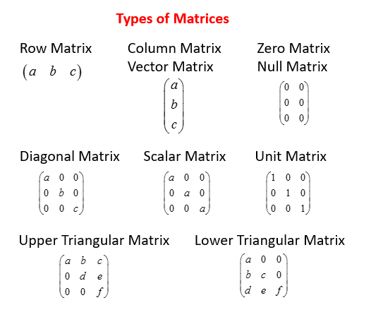
Types of matrix
Diagonal Matrix
Zero matrix
Upper triangular
Lower triangular
Identity matrix

Slide 25
Matrix Algebra
Two matrix are said to be equal if their dimensions are equal and all corresponding elements are equal.

Slide 26
Vector algebra
The addition and subtraction of two matrix , A and B of the same size yields a matrix C of the same size
Cij = Aij +/- Bij
It follows commutative law and associative law (for addition)
Matrix of different size cannot be added ad subtracted

Slide 27
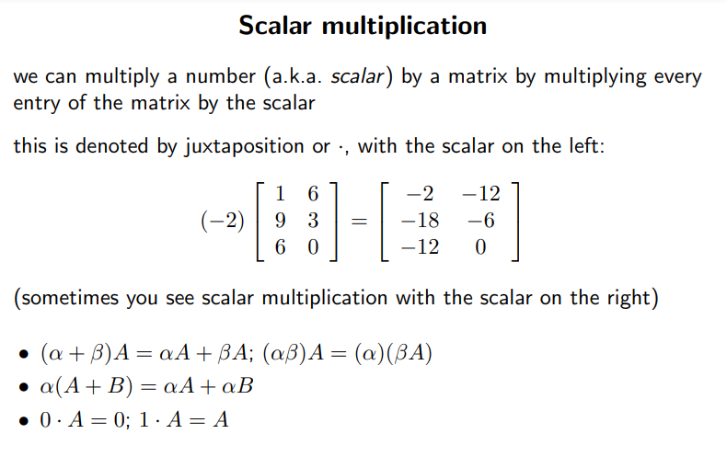
Scalar Multiplication
Matrix can be
multiplied by a scalar (constant)

Slide 28
Matric Multiplication
Necessary condition number of columns of A must be equal to number of rows of B

Slide 29
Transpose of matrix
Changing rows and columns

Slide 30
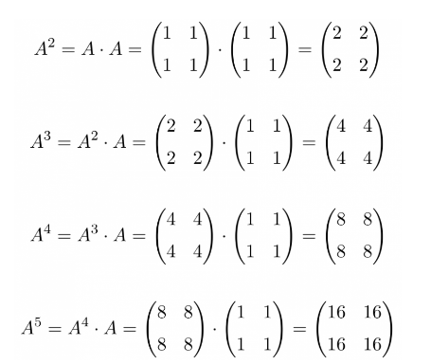
Power of matrix

Slide 31
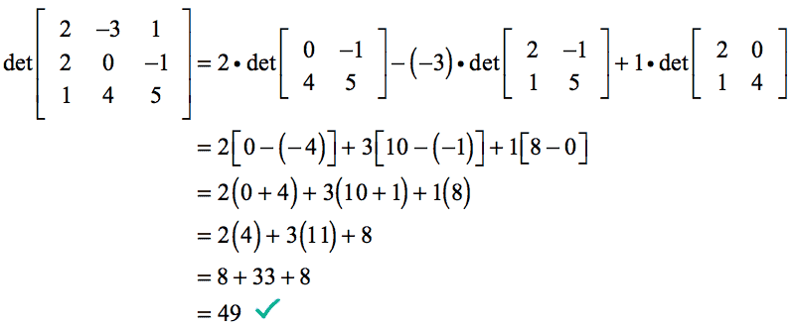
Determinate of matrix
Every square matrix has a determinate
The determinate of a matrix is a number

Slide 32
Inverse of matrix
K =7 K inverse = 1/7
Division of matrix is not defined instead matrix inversion is used
The inverse of a square matrix ,A if it exists is a unique matrix A-1 where
A A -1 == Identity matrix
When the determinate of a matrix is zero the matrix is singular
A matrix that does not have an inverse is called a singular matrix
A square matrix that has an inverse is called non singular matrix
Square matrix have inverses except when determinate is zero

Slide 33
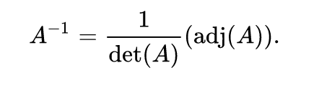
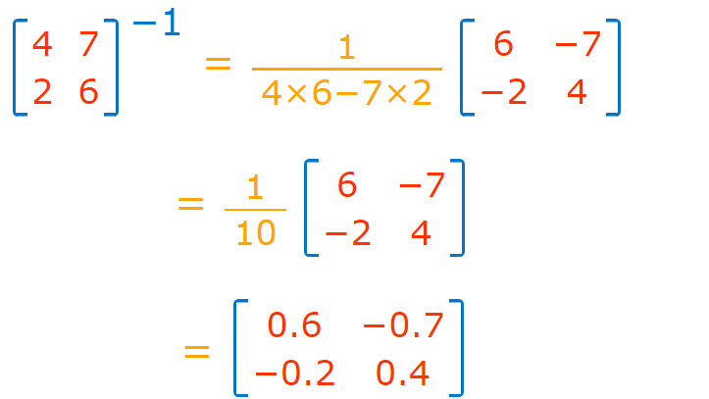
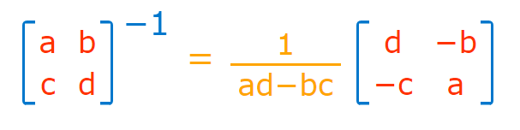
Inverse

Slide 34
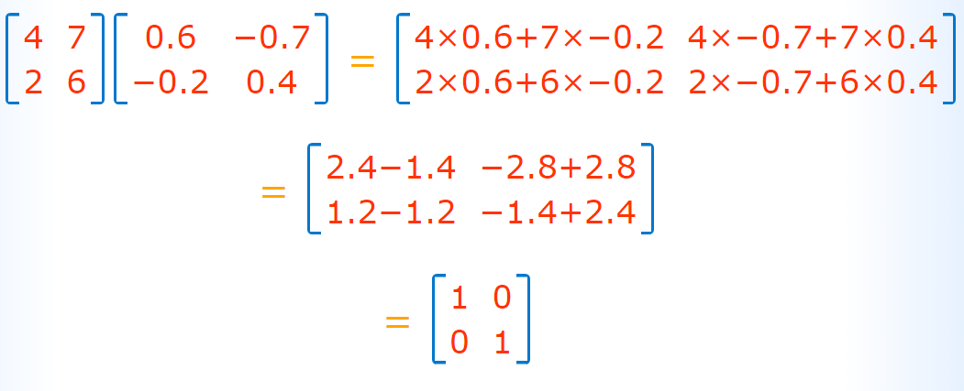

Slide 35
Matrix Rank
The rank is how many of the rows are "unique": not made of other rows. (Same for columns.)
The rank tells us a lot about the matrix.
It is useful in letting us know if we have a chance of solving a system of linear equations: when the rank equals the number of variables we may be able to find a unique solution.

Slide 36
Positive Definite Matrix
A square matrix A is positive definite(PD) if its is symmetric and
X^{T} A X > 0 non zero X
^{In} other words
X^{T} A X = 0 only if X =0
^{OR}
^{Sy}mmetric matrix A whose eigen values are positive is called positive definite
^{OR}
All principal minors of A are positive .

Slide 37
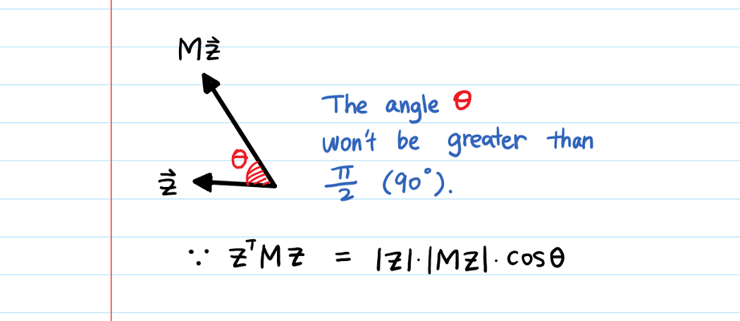
Use of SPD
There is a vector z.
This z will have a certain direction.
When we multiply matrix M with z, z no longer points in the same direction. The direction of z is transformed by M.
If M is a positive definite matrix, the new direction will always point in “the same general” direction (here “the same general” means less than π/2 angle change). It won’t reverse (= more than 90-degree angle change) the original direction.
Reading : https://towardsdatascience.com/what-is-a-positive-definite-matrix-181e24085abd

Slide 38
Diagonalization
A = X D X-1
Taking a matrix an writing it as a product of matrices one of which as value only along diagonal
X matrix is said to diagonalize A
Works only if
A has unique eigen value
If duplicate eigenvalue the linearly independent eigenvectors
D is made of eigen vales
X made of eigenvectors

Slide 39
SVD
Numeric

